Slide 1


Derick Ansyijar Kuule
PhD Student
Department of Environmental Management, Makerere University
Supervisors: Associate Professor Anthony Egeru; Turinawe Alice (PhD) & Associate Professor Barbara Schumann
Doctoral committee meeting presentation
27th/November/2024

Slide 2
Structure of the presentation
Key Highlights of the Research Proposal
Preliminary Output/Milestones
Current work (Data Analysis & Second Manuscript)
Gantt chart (Road Map to 2026 Graduation)

Slide 3
Title: SOCIAL CONFLICTS DYNAMICS AND EFFECTS ON LIVELIHOODS IN THE PASTORAL AND AGRO-PASTORAL COMMUNITIES OF KARAMOJA CLUSTER
Main objective
To assess the drivers of social conflicts and their effects on livelihoods at household and community level based on the local contexts
Specifically, the study will assess,
Determinants of social conflicts
Determine the effect of social conflicts on asset accumulation
Explore the role of local institutions on social conflicts’ compromise and escalation

Slide 4
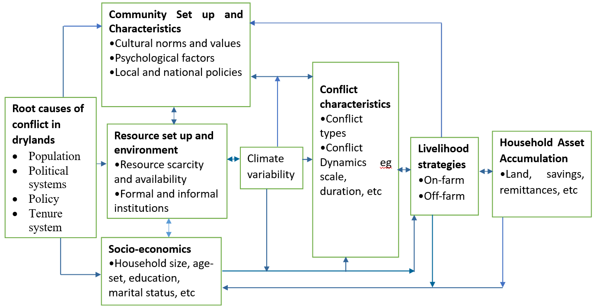
Conceptual framework

Slide 5
Objective 1: Determinants of social conflicts
Objective | Type of data to be collected | Data collection methods | Data analysis method | Study Approach
Objective 1: Determinants of social conflicts | -Data on forms of household and community level conflicts -Data on socio-economic and ecological resources -Weather/climate data. NASA Power data -In-depth data on community understanding of social conflicts, their drivers and seasonality | -Structured interviews. Baseline survey during the planting season Follow-up survey during post-harvest season Qualitative survey -Focus group discussions | -Descriptive statistics -Probit and multivariate probit models -Thematic analysis | Quantitative and qualitative

Slide 6


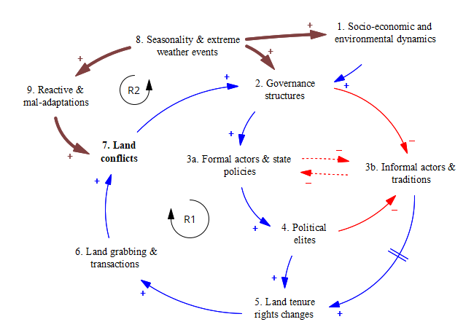



Key output: Multi-dimensionality and interconnectedness of social conflicts in the Karamoja sub-region in northeastern Uganda (DevRes Paper presentations 2024)
Methods and materials
Mixed methods approach
Female and male-separated FDGs
using rural participatory approaches
Findings
Five themes defined conflicts in Karamoja
Seasonal shifts and interlinkages observed in conflicts
Conclusion:
Community perspectives unraveled great insights into social conflict patterns.
Seasonal dynamics and interconnected conflict drivers are worthy considerations for conflict interventions
Climate Risk Management Journal

Slide 7
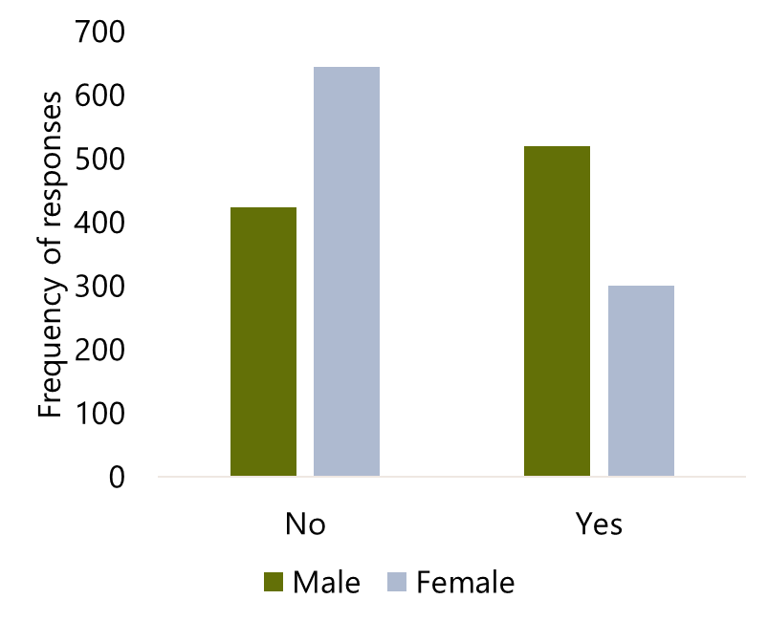
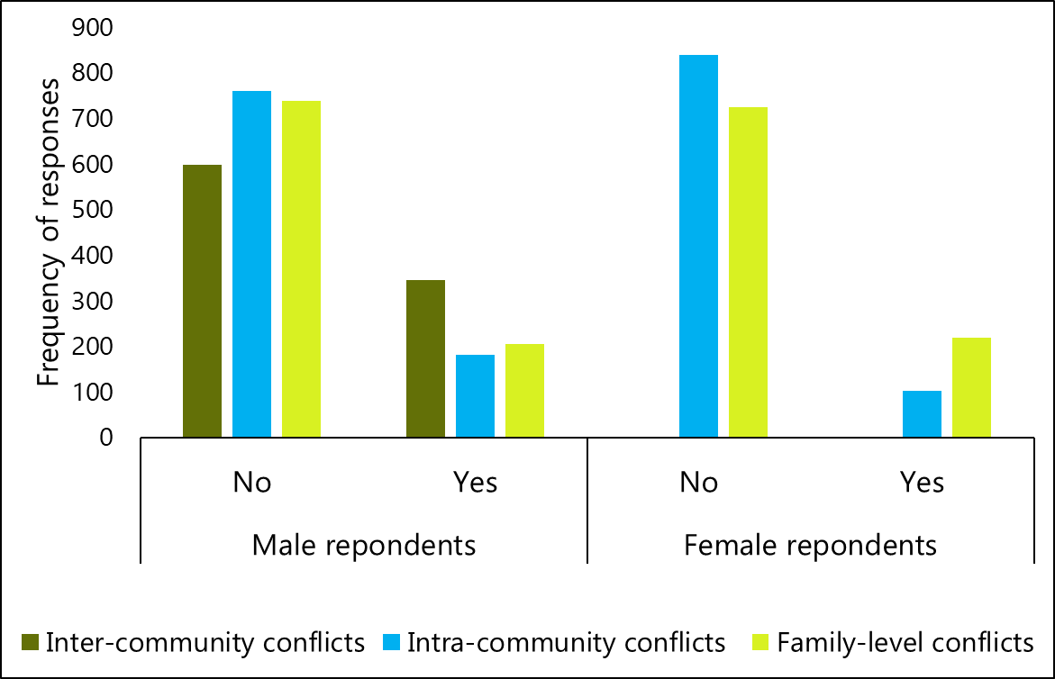
Current paper: DETERMINANTS OF SOCIAL CONFLICTS IN NORTH-EASTERN UGANDA AND NORTH-WESTERN KENYA.

Slide 8
Determinants of conflicts occurrence (Among Male Respondents)
Delta-method (Probit Model)
Determinants of conflicts (Male) | dy/dx | Std. Err. | z | P>z
Study site (Matany)
Chepareria | -0.321 | 0.061 | -5.26 | 0.000
Lokiriama | -0.270 | 0.088 | -3.07 | 0.002
Rupa | 0.213 | 0.050 | 4.24 | 0.000
Marital status (Polygamous)
Single/never married | 0.116 | 0.118 | 0.98 | 0.325
Monogamous | -0.066 | 0.031 | -2.13 | 0.034
Separated/divorced | 0.176 | 0.148 | 1.19 | 0.234
Widow/widower | -0.128 | 0.079 | -1.62 | 0.106
Household type (Female headed ) | -0.125 | 0.060 | -2.06 | 0.039
Family origin (Out of area) | -0.149 | 0.036 | -4.14 | 0.000
Wet season livestock land | 0.001 | 0.000 | 2.89 | 0.004
Migration with livestock (No) | 0.068 | 0.033 | 2.07 | 0.038
**Categories in the brackets are the reference categories

Slide 9
Effects of social conflicts on asset accumulation
Objective | Type of data to be collected | Data collection methods | Data analysis method | Study Approach
Objective 2: Effect of social conflicts on asset accumulation | -Household socio-economic and assets data | -Structured interviews | -Asset-based wealth index -Principal component analysis (PCA) -Fractional logistic regression model | -Quantitative

Slide 10
Exploring the role of local institutions on social conflicts compromise and escalation
Objective | Type of data to be collected | Data collection methods | Data analysis method | Study Approach
Objective 3: Exploring the role of local institutions on social conflicts compromise and escalation | -Data on social networks, membership in local institutions and informal groups -In-depth data on the interventions and weaknesses of informal institutions, CSOs & state agencies in conflict resolution | -Structured interviews Gender separated FDGs. Key informant interviews | -Multinomial probit model -Thematic analysis -Qualitative content analysis | -Quantitative and qualitative

Slide 11
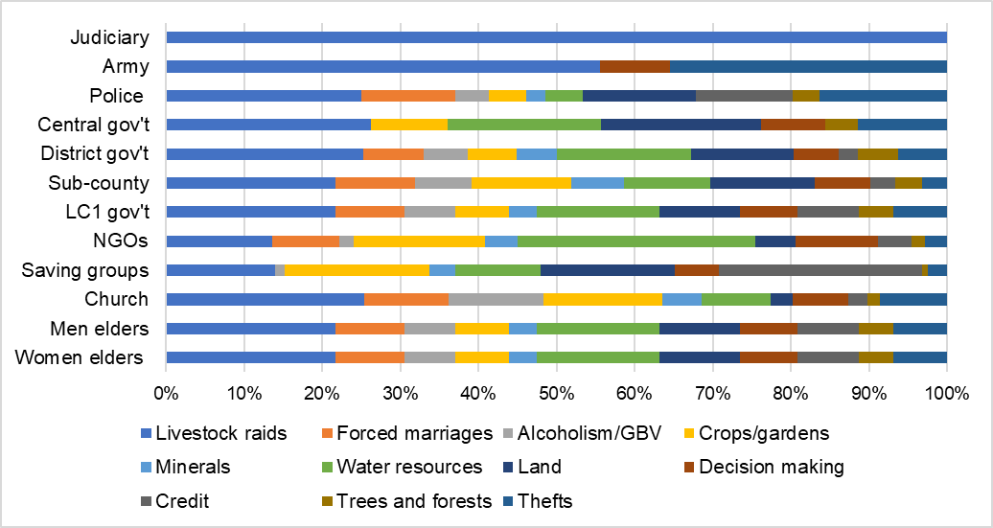

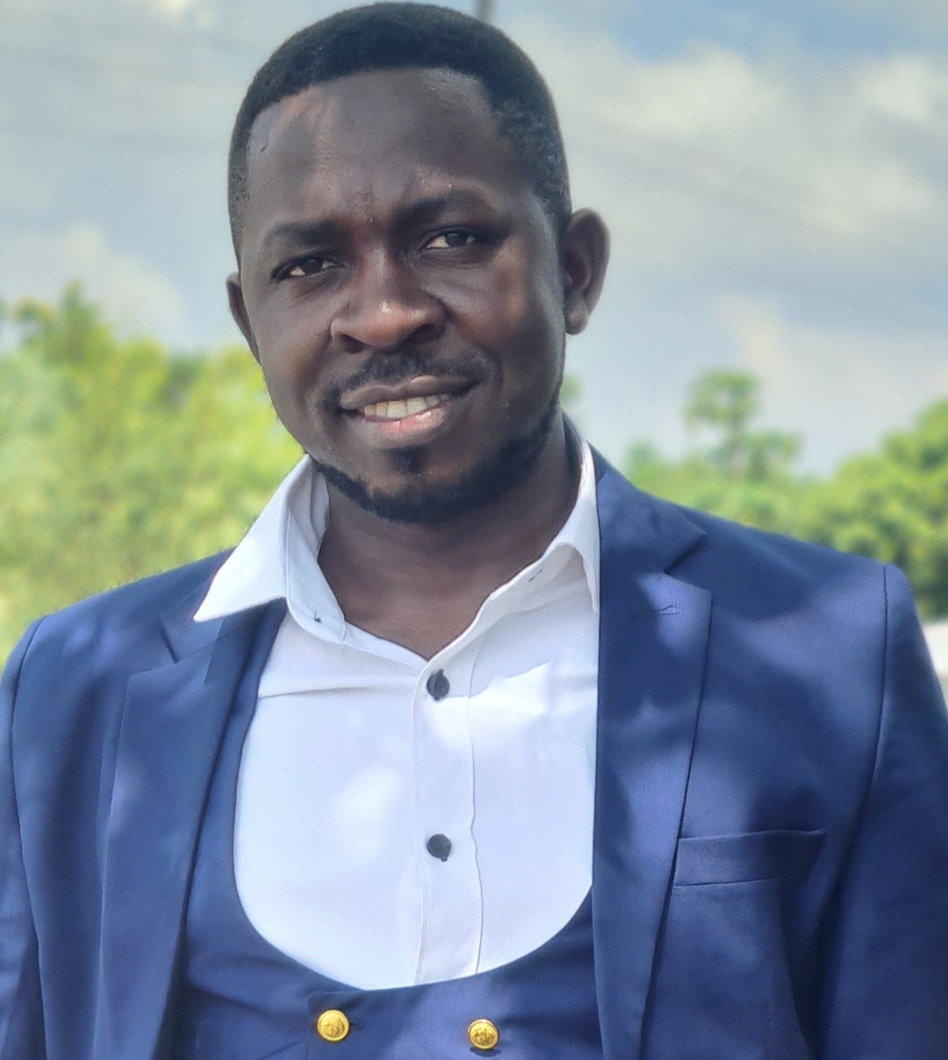

Key Output: THE ROLE OF LOCAL INSTITUTIONS ON SOCIAL CONFLICTS IN THE KARAMOJA CLUSTER
DERICK ANSYIJAR KUULE; KRISTINA LINDVALL; ALICE TURINAWE; GÖRAN BOSTEDT; BARBARA SCHUMANN & ANTHONY EGERU
Conclusion
There is a need to support collaborations between institutions and empower them with skills to foster proper management of conflicts.
Introduction
Drylands in the Karamoja border region have been prone to social conflicts for the past five decades. Effects on agricultural productivity, the well-being of communities, and global and national agendas exist.
Aim
Formal and informal institutions’ roles in social conflict compromise and escalation were explored to support policy and decision-making.
Materials and methods
-Gender-separated focus group discussions (FGDs), participatory rural appraisal techniques and key informant interviews (KIIs)
-Descriptive statistics and thematic analysis were conducted.
Preliminary results
Informal institutions dialogue, negotiate and establish punishments.
Formal institutions conduct awareness creation, invest in infrastructure
Formal institutions mobilize resources for informal institutions
Figure 1: Perceived focus of institutions on different forms of social conflicts
Emerging issues
Constraints in resources from formal institutions are central to conflicts
Alleged collusion and vested interests among actors
Makerere University
Derick Ansyijar,Kuule; (PhD student),
Department of Environmental Management;
P.0.Box 7062, Kampala, Uganda
E-mail: kulederrick@gmail.com
Phone: +256-700 117 550
Web: https://orcid.org/0000-0002-2564-0077
Poster AGRI4D 2023

Slide 12
PhD Award Requirements
Thesis title: Social Conflicts Dynamics And Effects On Livelihoods In The Pastoral And Agro-pastoral Communities Of Karamoja Cluster
Two publications
1. Multi-dimensionality and interconnectedness of social conflicts in the Karamoja sub-region in northeastern Uganda
2. Determinants of social conflicts in north-eastern Uganda and north-western Kenya.

Slide 13
Admission Timelines
Provisional admission: Effective 10th/August/2022 to 10th/August/2023
Full Admission: Effective 10th/July/2023 to 11th/July/2026
Drylands Transform Project Sponsorship: May 2022 to May 2025

Slide 14
WAY FORWARD
Date | 1st Manuscript (Dimensionality & interconnectedness of social conflicts in Karamoja Sub-region northeastern Uganda) | 2nd Paper (Determinants of social conflicts) Reviewing of 1st Manuscript | 2nd & 3rd objectives analysis Publication of 1st Manuscript Reviewing of 2nd Manuscript | Thesis, writing corrections and eidts, presentation at department, school, corrections Publication 1st & 2nd Manuscript | Thesis submission for examination | Viva; Thesis final edits and Final submissions
July-August 23
Sept -Dec 23
Jan-24
Feb-March 24
April-June 24
July-Aug 24
Sept-Dec 24
Jan-Feb-25
March-May 25
June-Aug 25
Sept-Nov 25

Slide 15
Request from the Doctoral committee
Comment on the academic performance and progress
Evaluate and comment on the quality of the work/research
Provide advice and guidance

Slide 16
Acknowledgment
The Supervisors
The Doctoral Committee Members
Drylands Transform Project
Department of Environmental Management
Thank you

